Slide 1
Expanding Tropical Diseases Area in Relation to Global Warming
By
Schehrbano, Russell, Monica, Kent
Notes:
Russ to talk about building viz
Sch to talk about the ETL
Monica to talk about interpreting data
Kentto do the idea

Slide 2
What are we analyzing?
Does the spread of tropical diseases correlate with climate change
The team decided to focus on Leprosy, Malaria, and yellow fever from the years 1980 to 2016
Notes:
The team wanted to explore if global warming was affecting the spread of diseases that are considered to be local to the Tropics.
The idea is, as the average global temperatures have increased the geographical areas of the diseases may have expanded.

Slide 3
The Data Sources
World Health Organization (WHO)
National Oceanic and Atmospheric Administration (NOAA)
HTML Tables from Google Dev Site for Lat/Lng
Notes:
We isolated the three diseases with the most data in relations to temperature and reported cases worldwide and geography
Compared the country code to the country code in the WHO table and discovered the proper Lat/Lng for each country
Consolidated the information and created sub query to extract the relevant data to display- Country name, disease, incident count, Lat
From the WHO we wanted the diseases instances from the countries over the 36 yrs
From NOAA API we extracted the average climate changes over the 36 yrs in a normalized delta avg temperatures between years

Slide 4
Assumptions
Focused on the most extreme (maximum and minimum) latitudes not the countries
The areas of disease spread were found by obtaining the latitude for a legitimate reporting of each disease
The analysis is strictly looking at normalized global average temperature and disease geographical area
Other factors that contribute to disease spread were not included
Notes:
The team isolated data via APIs from the World Health Organization,(WHO), and National Oceanic and Atmospheric Administration (NOAA)
Assumptions for data:
THE TEAM decided 3 or more cases is considered a significant-legitimate reporting in an area
The focus of the exercise is to find the latitudes not the countries
The latitudes were calculated by obtaining the max and min lat for a legitimate reporting
the three diseases with the most data in relations to temperature and reported cases worldwide and geography
The team isolated data via APIs from the World Health Organization,(WHO), and National Oceanic and Atmospheric Administration (NOAA)
Assumptions for data:
THE TEAM decided 3 or more cases is considered a significant-legitimate reporting in an area
The focus of the exercise is to find the latitudes not the countries
The latitudes were calculated by obtaining the max and min lat for a legitimate reporting

Slide 5
Information Flow
Mongo
DB
ETL in Jupyter Notebook
converted
Scraper.py
creates
Access
Mapbox.JS
Called by
GeoJSON
Hosted
Flask
Notes:
How did we connect the 3 data sets...country, temp and

Slide 6
Data Munging
Replaced N/A’s with zeros and verified that all the data was continuous
Data frames were created to ensure the data was:
Country, Latitude
Year, Avg Delta Temp
Year, Disease, Country, #Instances

Slide 7
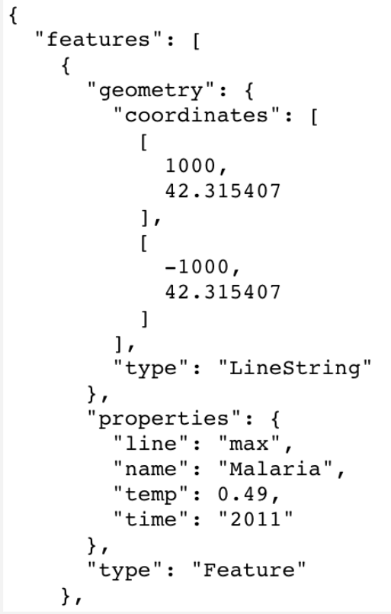
GeoJSON creation
Notes:
Had df and then looped thru
But geojson made it usable with the mapbox library
It needed properties geometry and Feature

Slide 8
Building the Visualization
Used properties key of GeoJSON to tie the year to a specific line coordinate for each disease
Filtered the lines by the associated year
Displayed temperature over the map, tied to the year using the GeoJSON properties

Slide 10
Interpreting the Visualization
The disease areas is represented by the distance between the corresponding lines
With the data used in this analysis, we were not able to strongly correlate the spread of diseases to the temperature change
Examples of other influencing factors are:
Modern medicine
Travel
Trade
Notes:
Display how the different diseases spread
data for years are missing
Data for Malaria starts at 2000 and Leprosy at 2005

Slide 11
Hurdles We Overcame
SQLite or MongoDB
Leaflet or Mapbox
Version control with Git Hub and needing more experience where this is used
Notes:
The initial choice was to use SQL Lite (to avoid a seperate server process)
We decided in the end to use MongoDB (Non-Structured Database) because it stores data in JSON format, which would be helpful for the visualizations.
Our original choice to use leaflet for the map and slider proved to be difficult because the documentation was limited and would take extra time to implement
By using our data in a GeoJSON format we could implement the mapbox map and slider.
Understanding the checkpoints and being able to recover code

Slide 12
Lessons Learned
Allot extra time for visualizations
Use of a Kanban board was useful initially but team then fell into our roles
Commit to GitHub more often to avoid the loss of code.
Notes:
The development of the visualization took more time than we expected, we ended up changing data format and libraries in the end due to the difficulties in getting the viz we wanted.
Kanban was a great tool to help us organize the start of the project.
Having the most current code in GitHub is important. In order to do this we need a better understanding of how to work with multiple branches and merging.

Slide 13
Where We Excelled
Controlled scope well
Team fell into roles seamlessly
Stated our assumptions and documented them
Structured our outputs so that the next step would be most efficient
Used each others strengths, PM, ETL, VIZ, Resolving all bugs
Met and communicated often

Slide 14
Requirements
Python Flask
RESTful API
HTML/CSS
JavaScript
MongoDB
Mapbox with slider library

Slide 15
Appendix
Imported the mapbox library from a CDN
Initially the team wanted to use the Leaflet.timelineSlider or Leaflet Time-Slider

Slide 16
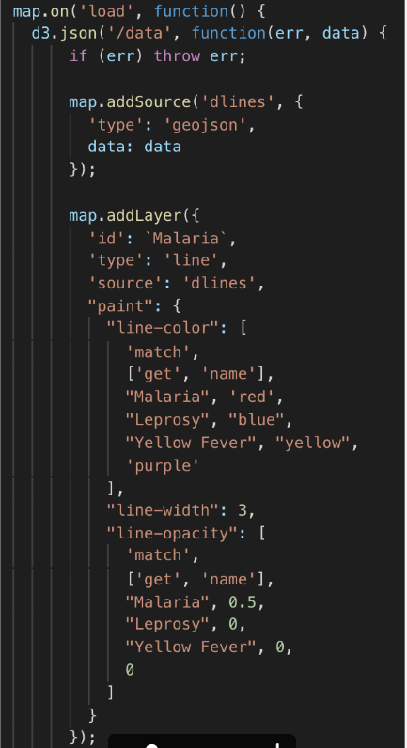
Functions in Mapbox are similar but different from Leaflet, especially conditional formatting
This allowed the slider to be used with multiple categories at the same time

